Slide 1

Towards 5G AKE: The security and privacy of 3G/4G AKA
With P.-A. Fouque (UR1),
B. Richard, G. Macario-Rat (Orange)
S. Alt (DGA)

Slide 2
Authenticated Key Exchange

Slide 3
Secure Channels
Goal:
Insecure channels:
  The Internet (HTTP://)
  Mobile networks (2G, 3G, 4G…)
  Bluetooth
  Radio Frequency Channels
“Secure” channels:
  Messages exchanged over this channel could be intercepted, but not read by active 3rd parties (Man-in-the-Middle attackers)
Secure communication over insecure channels

Slide 4



Typical 2-Party AKE
Authentication
& KE
Secure Channel

Slide 5
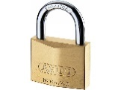

Security of AKE
Meet the adversary:
  A Man-in the Middle, aims to break channel security
  Can interact in multiple sessions of many parties
  Can corrupt parties to learn long-term keys
  Can reveal computed session keys
  Forward-secrecy: if the adversary corrupts a user, it cannot break the security of past sessions
AKE + SC

Slide 6
Real-world AKE
In practice, ensures:
  Secure Internet browsing (TLS/SSL)
  Mobile services (AKA)
  Payments
  Personal identification (ID cards/passports)
Security of protocol only proved for 2-party use
  Yet sometimes, handshakes are proxied, by semi-trusted third parties
Is the resulting protocol still secure?

Slide 7
The case of AKA

Slide 8



AKA and 3G/4G networks
Communication as a service for mobile users
  Users (clients) subscribe to an operator…
  … and expect service anywhere, everywhere
Service provided by servers:
  Local service: usually affiliated with client’s operator
  Roaming: server affiliated with partnering operator
  Requirement: secure Client-Server channel, with server only semi-trusted
Client
Server
Operator
Radio link
Secure
channel

Slide 9
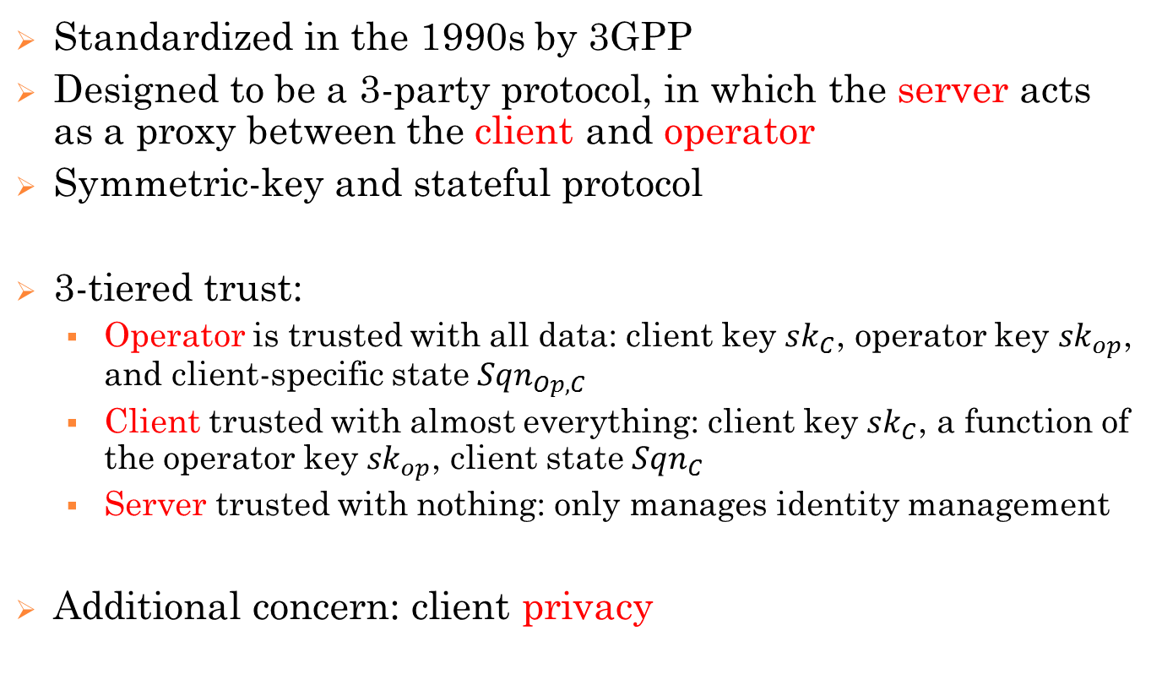
The AKA protocol
Standardized in the 1990s by 3GPP
Designed to be a 3-party protocol, in which the server acts as a proxy between the client and operator
Symmetric-key and stateful protocol
3-tiered trust:
  Operator is trusted with all data: client key $sk_{C}$, operator key ${sk}_{op}$, and client-specific state ${Sqn}_{Op, C}$
  Client trusted with almost everything: client key $sk_{C}$, a function of the operator key ${sk}_{op}$, client state ${Sqn}_{C}$
  Server trusted with nothing: only manages identity management
Additional concern: client privacy

Slide 10
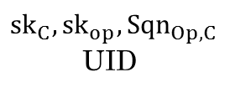

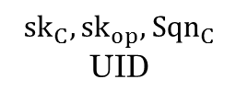

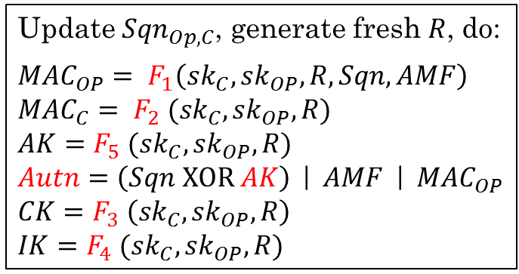



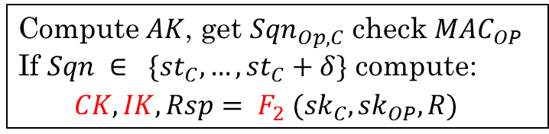
The basic 2-party Protocol
$${sk}_{C}, {sk}_{op}, {Sqn}_{C}$$
UID
$${sk}_{C}, {sk}_{op}, {Sqn}_{Op,C}$$
UID
$$UID$$
Update ${Sqn}_{Op,C}$, generate fresh $R$, do:
$${MAC}_{OP}= F_{1}\left({sk}_{C}, {sk}_{OP}, R, Sqn, AMF\right)$$
$${MAC}_{C}= F_{2} ({sk}_{C}, {sk}_{OP}, R)$$
$$AK=F_{5} ({sk}_{C}, {sk}_{OP}, R)$$
$Autn=\left(Sqn XOR AK\right)$ | $AMF$ | ${MAC}_{OP}$
$$CK=F_{3} \left({sk}_{C}, {sk}_{OP}, R\right)$$
$$IK=F_{4} ({sk}_{C}, {sk}_{OP}, R)$$
$R$ | $Autn$
Compute $AK$, get ${Sqn}_{Op,C}$ check ${MAC}_{OP}$
If $Sqn ∈ \{{st}_{C}, …, {st}_{C}+δ\}$ compute:
$CK, IK, Rsp= F_{2} ({sk}_{C}, {sk}_{OP}, R)$
$$Rsp$$
Else: $Resynch$
Check: $Rsp== {MAC}_{C}$

Slide 11

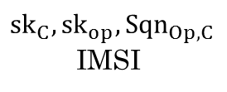
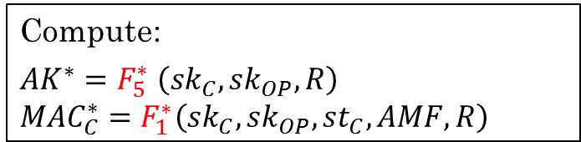

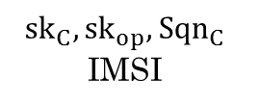
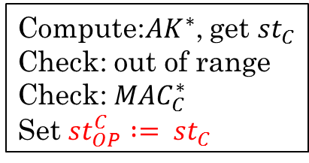
Resynch Procedure
$${sk}_{C}, {sk}_{op}, {Sqn}_{C}$$
IMSI
$${sk}_{C}, {sk}_{op}, {Sqn}_{Op,C}$$
IMSI
If ${MAC}_{OP}$ verifies, but $Sqn$ out of range
Compute:
$${AK}^{∗}=F_{5}^{∗} \left({sk}_{C}, {sk}_{OP}, R\right)$$
$${MAC}_{C}^{∗}=F_{1}^{∗}\left({sk}_{C}, {sk}_{OP},{st}_{C}, AMF, R\right)$$
$\left({st}_{C} XOR {AK}^{∗}\right)$ || ${MAC}_{C}^{∗}$
Compute:${AK}^{∗}$, get ${st}_{C}$
Check: out of range
Check: ${MAC}_{C}^{∗}$
Set ${st}_{OP}^{C} := {st}_{C}$
Start from there.

Slide 12
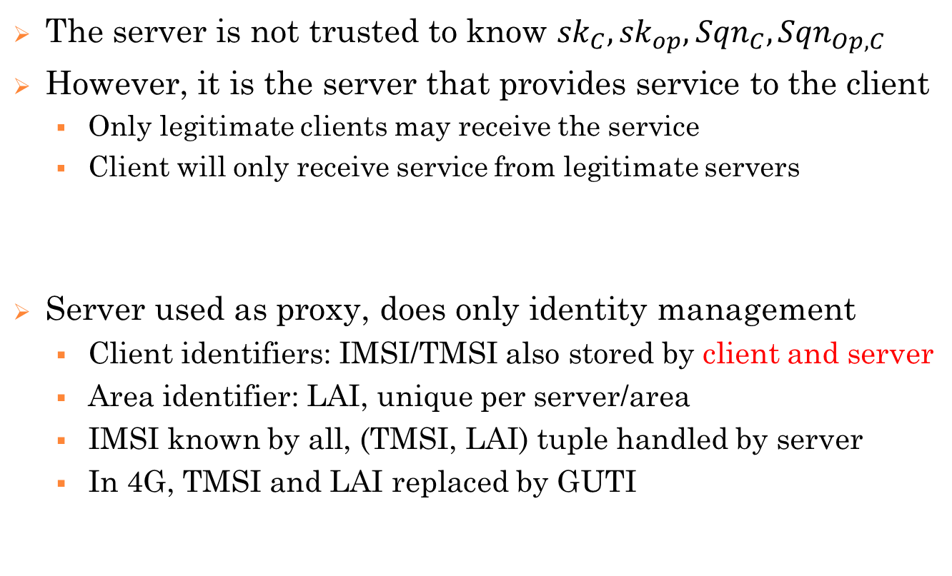
Introducing the third party
The server is not trusted to know ${sk}_{C}, {sk}_{op}, {Sqn}_{C}, {Sqn}_{Op,C}$
However, it is the server that provides service to the client
  Only legitimate clients may receive the service
  Client will only receive service from legitimate servers
Server used as proxy, does only identity management
  Client identifiers: IMSI/TMSI also stored by client and server
  Area identifier: LAI, unique per server/area
  IMSI known by all, (TMSI, LAI) tuple handled by server
  In 4G, TMSI and LAI replaced by GUTI
How can authentication work without client secrets?

Slide 13



AKA protocol structure
Client
Server
Operator
$${sk}_{C}, {sk}_{op}, {Sqn}_{C}$$
$${sk}_{C}, {sk}_{op}, {Sqn}_{Op,C}$$
(TMSI, LAI) or IMSI
Get IMSI
Batch
Auth.vectors
Challenge-Response
TMSI reallocation

Slide 14


Security Weaknesses of AKA
Server impersonation by offline relays
Main causes:
  No authentication of UID
  No nonce on client side
UID Request
UID Request
IMSI/TMSI, LAI
IMSI/TMSI, LAI
Auth.
challenge
Auth.challenge

Slide 15




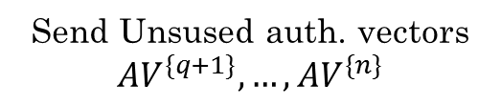
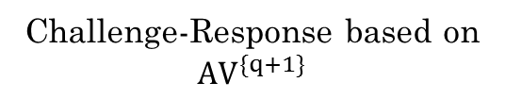
Security Weaknesses of AKA (cont’d)
Impersonation/key-distinguishing attack [ZF03]:
Corrupted Server S
Send Unsused auth. vectors ${AV}^{\{q+1\}},…, {AV}^{\{n\}}$
Client C
Server S*
Operator Op
User identifier
Challenge-Response based on
${AV}^{\{q+1\}}$

Slide 16
Security of AKA
What AKA guarantees:
  C-imp. security: even for server corruptions & offline relays
  S-imp. security: no server corruptions, no offline relays
  Key-indistinguishability: no server corruptions
  State confidentiality
  Soundness
Where AKA security fails:
  Server corruption attacks reveal session keys
    Thus even sessions in “safe” areas are vulnerable
  IMSI/TMSI insecurity leads to offline relays

Slide 17
Privacy of AKA
3GPP requirements:
  ID-Hiding: nobody can trace the client’s IMSI
  Location-hiding: nobody can trace the client’s LAI
  Untraceable: nobody can link services to clients
“IMSI catcher” [S07] attackers
break the first two:
  First get the LAI
  Then force IMSI revelation
  [BVR15]: encrypt TMSI with PKE
  But this still allows traceability
UID Request
TMSI/LAI
R/LAI
IMSI Request
IMSI

Slide 18


Traceability Attacks
Distinguishing between two clients allows traceability
UID Request
UID Request
(Encrypted) UID
(Encrypted) UID
Auth.
challenge
Auth.challenge
Adv. does not know
which client this is
But he can trace it

Slide 19
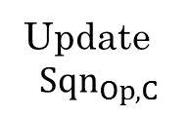
Traceability by resynchronization
UID Request
UID Request
IMSI/TMSI
IMSI/TMSI
Auth.
challenge
Update
$$Sqn_{Op,C}$$
Auth.challenge
No update
Resynchronization
Failure (wrong key)
Attack repeated a number of times

Slide 20
Traceability by TMSI-Reallocation
UID Request
UID Request
IMSI/TMSI
IMSI/TMSI
Auth.challenge
Response
Enc(TMSI)
random

Slide 21
Our counter-proposals
Easy fix: security even with server corruptions
  Add server identifier to all cryptographic functions
  Even if a server is corrupted, the adversary cannot use its identity in a different area
Harder fix: better privacy
  Encrypt TMSI in smarter way:
    Use symmetric encryption inside PKE scheme
    Use Operator as soon as an attack is detected
  Remove need for resynchronization
  Add authentication at TMSI reallocation
  Optimality: impossibility result for better privacy

Slide 22
Towards 5G

Slide 23
Need for new primitives
3G/4G AKA provides some limited security
  And we can fix it to get better privacy
Some AKA problems:
  Currently all computation done at the operator’s end
  Legal interceptions: operators reveal long-term keys
    … thus giving away more data than necessary
  Strong deviation in practical implementations
    For instance TMSI, LAI not always used in practice since “you have no privacy, get over it!”
  Application-layer primitives problematic
  No concept of “end-to-end”, everything goes through Op
But should we use it for 5G networks?

Slide 24
Challenges for 5G
A fundamental leap (akin to TLS 1.3 vs 1.2)
What we need:
  Protocol that allows for unfederated E2E security
    … including Peer-to-Peer types of connections
  Usability: must answer to Legal Interceptions
    But we should allow operators to give away less data
  Different handshakes for different situations:
    Roaming and domestic
    Client-server vs. P2P
  Better application-layer primitives
    Including lightweight primitives for data-stream transfer
  Efficiency, compliance to legal standards, ease of use!

