Slide 1
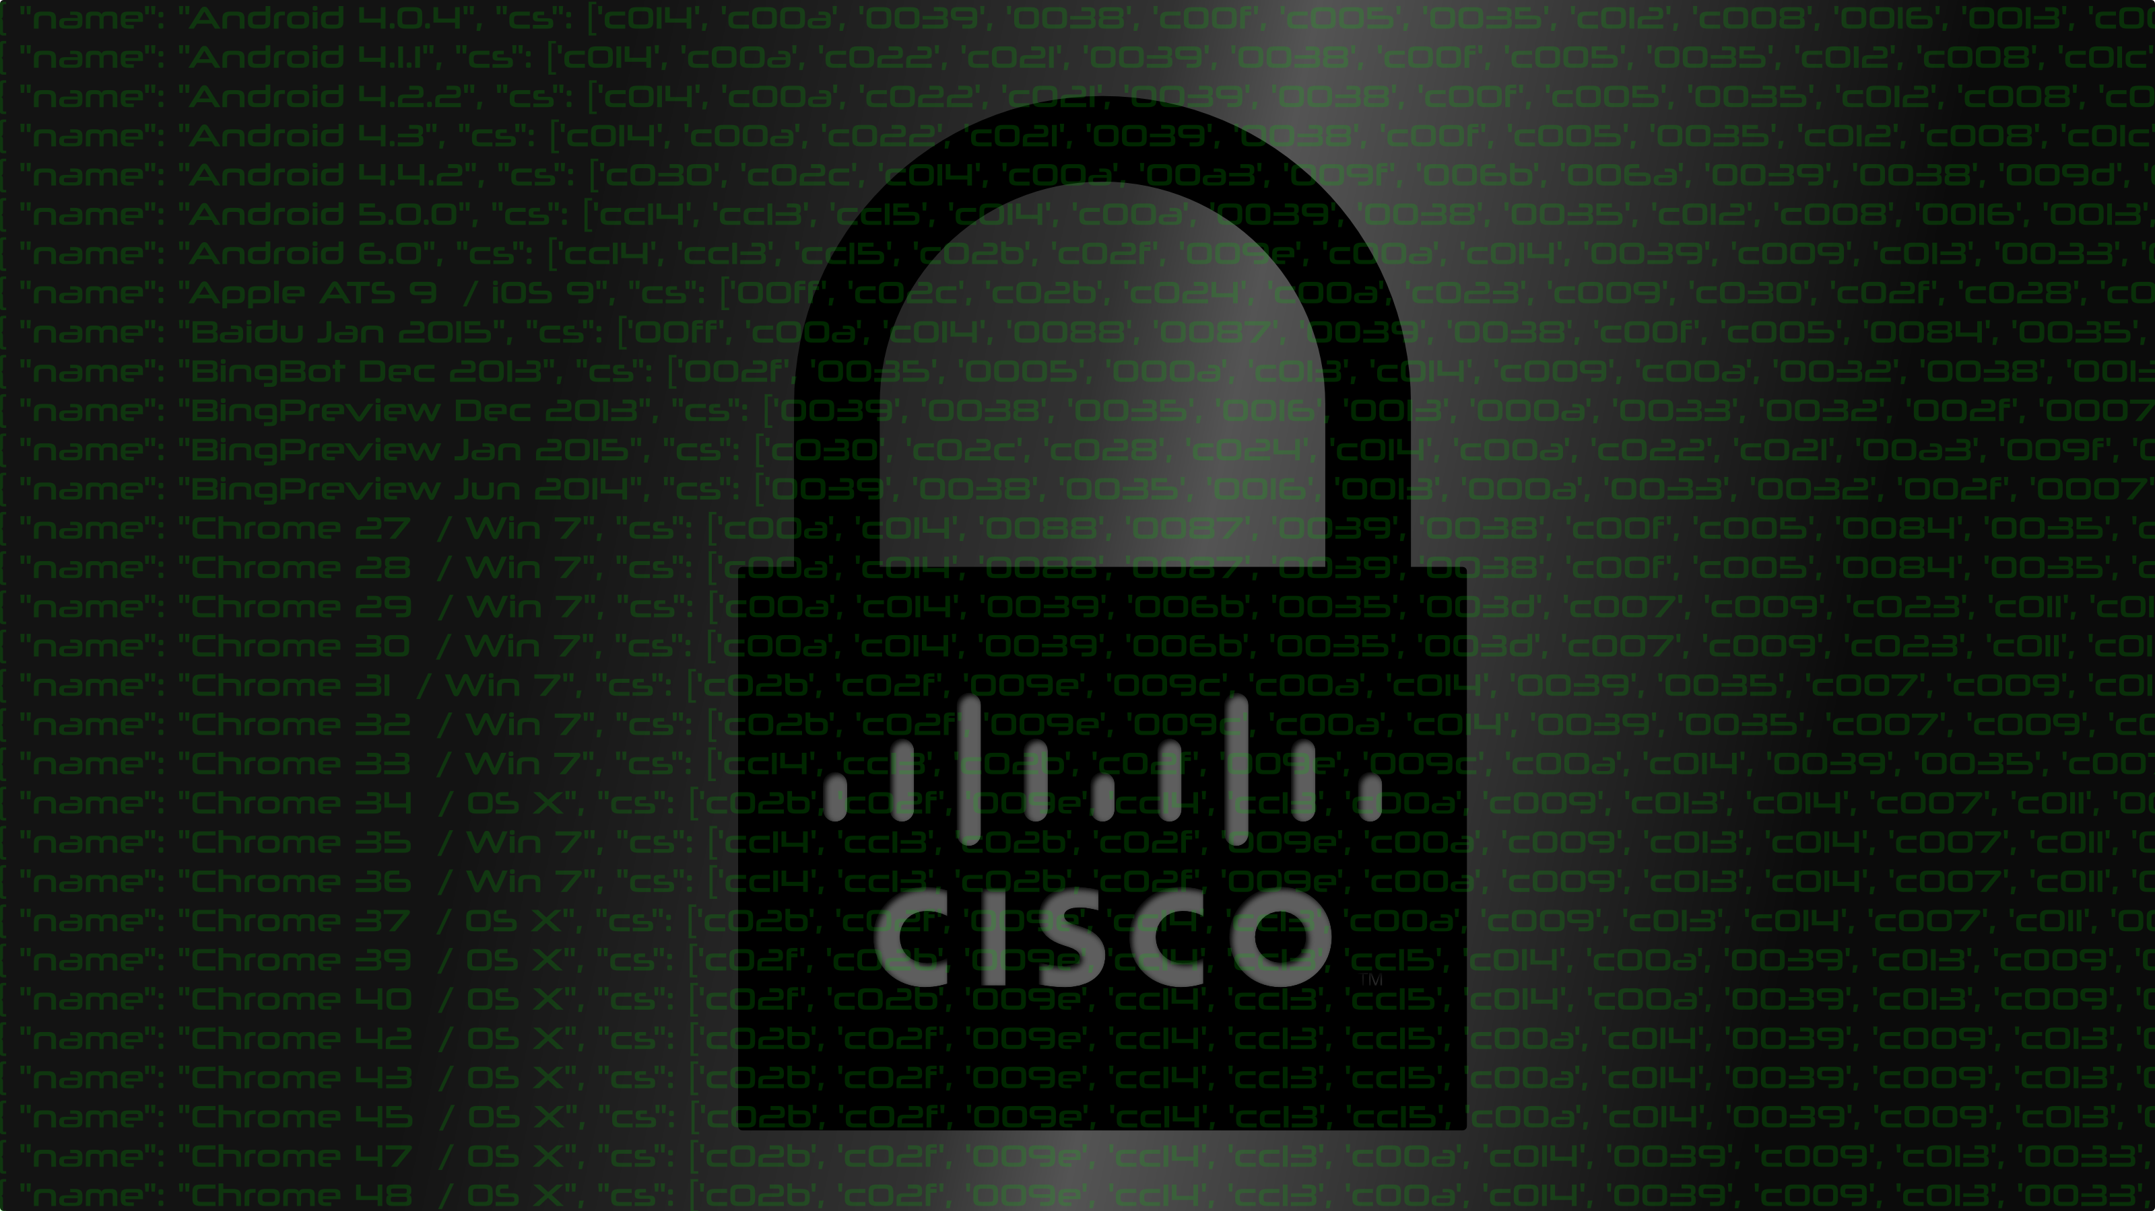
PRNG Failures and TLS Vulnerabilities in the Wild
David McGrew, Blake Anderson, Scott Fluhrer, Chris Shenefiel
Cisco Systems
Real World Crypto
Janaury 6, 2017

Slide 2
People
David
Blake
Scott
Chris

Slide 3
Background

Slide 4
Previous and Related Work
Previous
  Ristenpart and Yilek, When Good Randomness Goes Bad: Virtual Machine Reset Vulnerabilities and Hedging Deployed Cryptography, NDSS 2010
  Böck, Zauner, Devlin, Somorovsky, Jovanovic , Nonce-Disrespecting Adversaries: Practical Forgery Attacks on GCM in TLS
Related
  Bernhard, Cohney, Halderman, Heninger, Valenta, Ongoing related work, similar findings

Slide 5




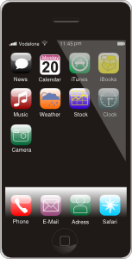

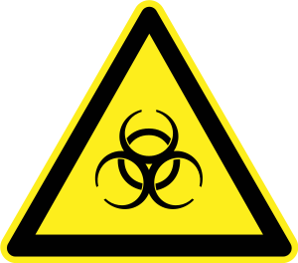


A Threat-Driven Approach to Cryptography
Threats
Controls
Vulnerabilities
Assets
CVE
CVE
CVE
CVE

Slide 6


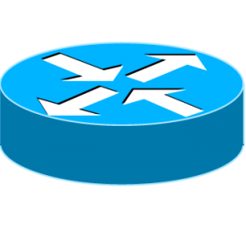

Slide 7
Crypto Visibility
Is encryption used where needed?
  Sensitive data
Are there active attacks/exploits?
Where are bad certificates/keys in use?
Where is weak crypto being used?
  Weak cryptography
  Implementation flaws

Slide 8
Detecting flaws

Slide 9
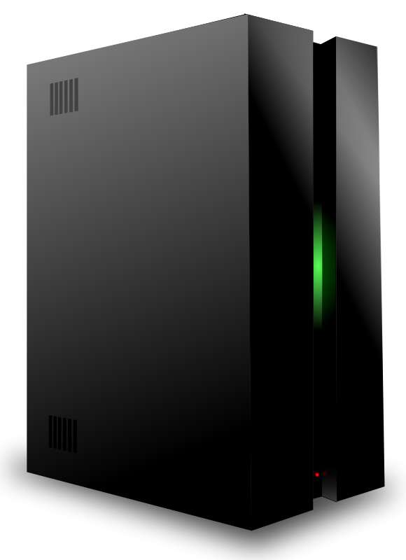
Multisession Monitoring

Slide 10
Multisession Monitoring
All Possible PRNG States
Nonce
Generator
RSA
Encrypt
Clock
PRNG
N Typical PRNG States
Entropy
Observing Sqrt(N) states will find collision

Slide 11





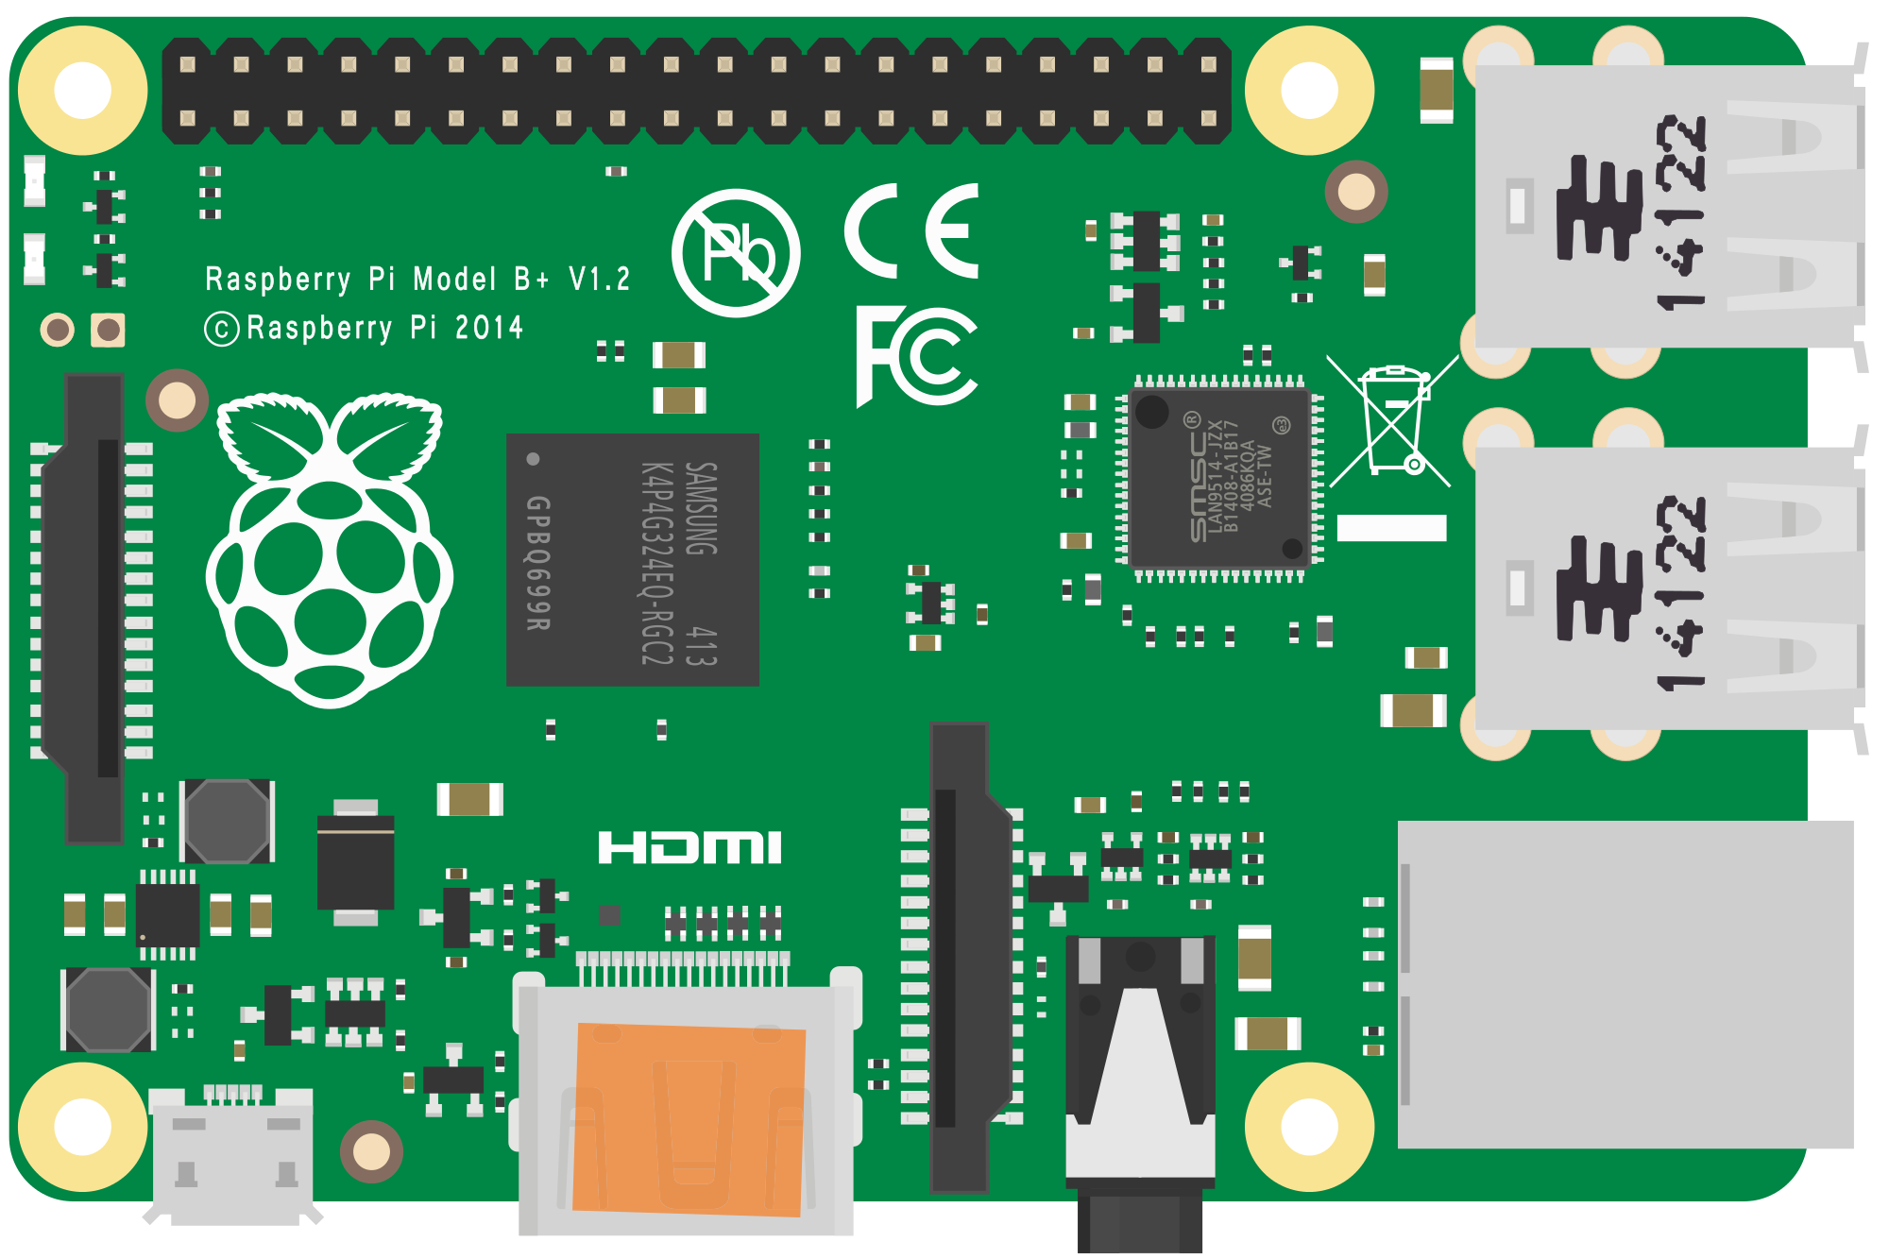

Tools
pcap
^{joy}
json
https://github.com/davidmcgrew/joy

Slide 12
Virtual Machines

Slide 13

Virtual Machines
1011
0110
1011
0110
Snapshot
Clone
1011
0110
1011
0110

Slide 14
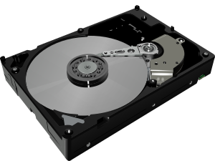
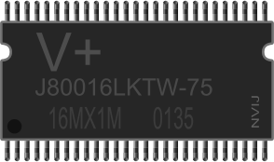
Volume Snapshot
Full Snapshot
Image of bootable disk
Boot latency
Not vulnerable
Image of RAM + disk
No boot latency
Vulnerable

Slide 15
VM experiments
Full Snapshot
Sandbox
  ThreatGRID with Windows 7 SP1
Linked clones
  VMWare ESXI 6.0 Update 2 with Windows 7 SP1
Derivative Docker containers
  CentOS 7 on Docker server with Ubuntu 16.04 container image
Volume
Volume

Slide 16

Turtles all the way down
Application
Container
Virtual Machine
Operating System

Slide 17
TLS Failure Scenarios
Aberrant implementation
PRNG failure
Multiple Running Instances of Full Snapshot (MRIFS)

Slide 18
TLS Random Nonces
struct {
uint32 gmt_unix_time;
opaque random_bytes[28];
} Random; // Client
struct {
opaque random_bytes[32];
} Random; // Server
Time
Random Bytes
Random Bytes
Notes:
Distinct across all sessions
Prevents replay attacks
Provides unpredictable input to key derivation function

Slide 19
Simple TLS model
Failures propagate along DAG
Time
Random
clientKeyExchange
Nonce
Generator
RSA
[EC]DH
Clock
PRNG
Entropy

Slide 20
Aberrant implementation
Does not attempt to conform to spec, or fails to do so
May be fixed or otherwise repeating
Time
Random
clientKeyExchange
Nonce
Generator
RSA
[EC]DH
Clock
PRNG
Entropy

Slide 21
PRNG flaw
Repeating PRNG values (e.g. slow updating)
Distinct
May Repeat
May Repeat
Time
Random
clientKeyExchange
Nonce
Generator
RSA
[EC]DH
Clock
PRNG
Entropy

Slide 22
Multiple Running Instances of a Full Snapshot
Distinct
May Repeat
May Repeat
Time
Random
clientKeyExchange
Nonce
Generator
RSA
[EC]DH
Nonce
Generator
RSA
[EC]DH
Clock
PRNG
Clock
PRNG
Clone
Entropy
Entropy

Slide 23
Active network scan
Successive sessions with same clientHello.random, clientKeyExchange to different destinations, from one source

Slide 24
TLS Failure Field Identification Chart
Aberrant
PRNG failure
MRIFS
Time
Random
clientKeyExchange
Time
Random
clientKeyExchange
Time
Random
clientKeyExchange
Time
Random
clientKeyExchange
Time
Random
clientKeyExchange
Time
Random
clientKeyExchange
Time
Random
clientKeyExchange
Time
Random
clientKeyExchange
Time
Random
clientKeyExchange
Time
Time
Random
clientKeyExchange
Time
Random
clientKeyExchange
Time
Random
clientKeyExchange
Time
Random
clientKeyExchange
Time
Random
clientKeyExchange
Time
Random
clientKeyExchange
Time
Random
clientKeyExchange
Time
Random
clientKeyExchange
Time
Random
clientKeyExchange
Same address
Addresses may be different

Slide 25
Observations in the Wild
Total | 28,095,906 TLS sessions
Aberrant | 4 instances
PRNG Library | 1 instance
VM snapshot | 1 instance
~1000 hosts on two enterprise networks

Slide 26
Observations in VM sandbox
Malware Family | Tescrypt
Malware Sample SHA1 | a099be9de7b1fd4d3038dd396b38fb20902b4ffa
ThreatGRID OS | 7601.17514.x86fre.win7sp1_rtm.101119-1850
Runs | 6
Probable library | IE 11 - 0x003c
Ciphersuite | TLS_RSA_WITH_3DES_EDE_CBC_SHA
Server DNS | *.tor2web.org
Random | f8e820a8f6b74f0d0d859eba67448176bea69bcf1aebffabda5d2877
 | Repetition: 5
ClientKeyExchange | 225d879a437eeab69723f9b5e0e8559cdd309edd501573e2…
 | Repetition: 5

Slide 27
Cryptographic attacks
Replay, and cut and paste records between colliding sessions
Flawed server with [EC]DSA → private key recovery
Flawed client
  Act as server for colliding session → get session keys
  Downgrade colliding session to EXPORT → find original keys
Flawed client with RSA
  Replay colliding session → cause symmetric keys to collide
  RC4, GCM, CCM, ChaCha: plaintext leakage
  CBC: partial plaintext leakage
  GCM: authentication key leakage

Slide 28
Conclusions

Slide 29
Conclusions (1 of 2)
TLS PRNG/Implementation failures do happen
Passive network crypto visibility can help detect them
  Good guys should have the same visibility as attackers!
Multisession monitoring is needed

Slide 30
Conclusions (2 of 2)
VMs
  Full snapshots MUST NOT be used in production
TLS SHOULD NOT use RSA encrypted key transport
Robustness
  [EC]DSA SHOULD use deterministic variant [RFC 6979]
  Alternative: stir PRF(message) into entropy prior to signature
Robust AEAD SHOULD be used
  AES-GCM-SIV
Non-robust AEAD MUST be tested

Slide 31
Thank You
We’re hiring!
mcgrew@cisco.com

