Slide 1
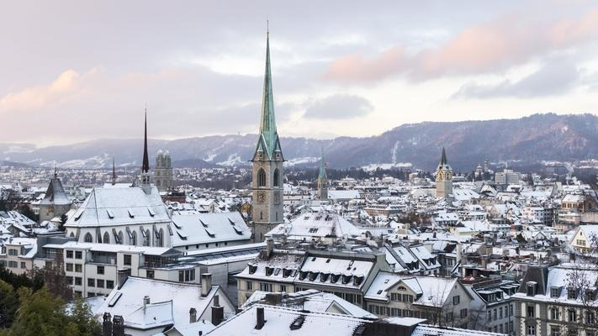




Real-World Crypto 2018
January 10-12, Zurich
WiFi: rwcs2018
Co-organized by IBM Research – Zurich & Google

Slide 2
2018 is Different
First RWC supported by IACR
  International Association of Cryptologic Research
  Provides financial stability for the conference going forward
  You are all (*) now members of the IACR for 2019
  You can hence vote in IACR elections in 2019
  We have approx 600 participants, hence RWC is the
  Biggest IACR Event Ever!!!
  Format of RWC stays the same though
(*) Unless you opted out

Slide 3
Where Are You From?

Slide 4
2018 is Different
Even with the IACR fee registration is still very low
  Due to generous sponsorship from companies
  Companies donate to the conference, they get nothing formal in return
  Every cent donated goes to support the conference
  Low registration means we get a more diverse audience
  Looking for sponsors to support the event next year

Slide 5
2018 is Different
Over 50k USD support for student attendance
    Thank again to the sponsors and the NSF
    Special Google scholarships for female attendees
Lot of logistic support by University of Bristol re finances given for free
    Paying a lot of stipends
    Collecting a lot of sponsorship money
  New code of conduct for participants (see the web page)

Slide 6
2018 is Different
A bigger program committee sifted through the contributed talks
  Number of submissions: 95 (!)
  Number of long accepted talks: 13 (25 mins)
  Number of short accepted talks: 7 (five that are 15 mins + 2 that are five mins)
  Number of invited talks: 15
  Number of reviews generated by the committee: 295
Selection criteria of talks are
  Interest to RWC audience
  Novelty
  Timeliness
  Quality of speaker

Slide 7
RWC 2018 Contributed Talks Committee
Dan Boneh Stanford University
Alexandra Boldyreva Georgia Tech University
Ian Goldberg University of Waterloo
Nadia Heninger University of Pennsylvania
Brian A. LaMacchia Microsoft Research
Anja Lehmann IBM Research Zurich
Aggelos Kiayias University of Edinburgh
Kenneth G. Paterson Royal Holloway University of London
Thomas Ristenpart Cornell Tech
Thomas Shrimpton University of Florida
Brian Sniffen Akamai
Nicholas T. Sullivan Cloudflare

Slide 8
2018 is the Same
Weds 12.00: Levchin Prize
  We will be awarding the two Levchin prizes for 2018
  Who will win this year? It could be you!
Thurs 12.15: Lightning Talks
  Queue up to give a two minute pitch
  No slides, just your wits and charisma
Keeping Current/Timely
  Special talk Thurs on Spectre and Meltdown by Jann Horn

Slide 9
RWC 2019....
Will be in Bay Area, probably San Jose
See RWC web page for
  Suggesting invited speakers
  Suggesting Levchin winners
  Details of contributed talks procedure (coming soon)

Slide 10
Local Information
Speakers are treading the boards of a venue more renowned for rock acts.
When speaking remember AC/DC, Black Sabbath, Red Hot Chilli Peppers and Amy Winehouse have also played this venue.
But remember no crowd surfing is allowed at RWC!
Encrypt
So Lets Rock

Slide 11
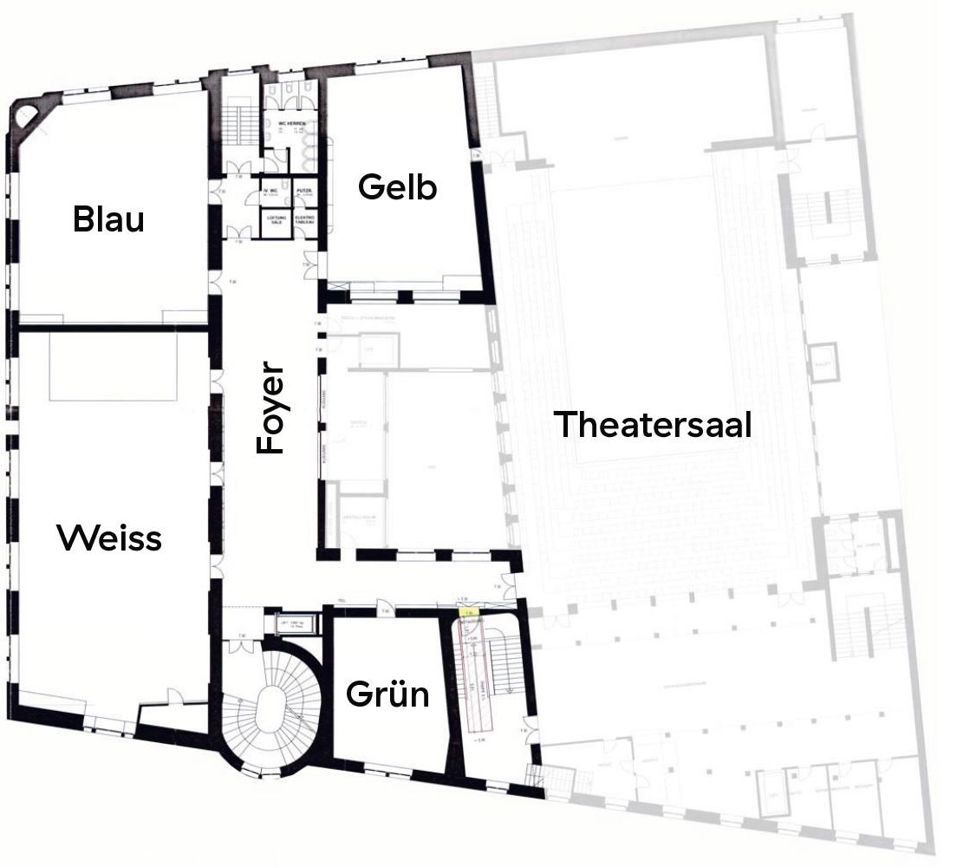
Local Information
WiFi: rwcs2018
Lunch breaks upstairs
Weisser, Gelber (& Blauer) Saal
Small meeting room upstairs
Grüner Saal
Welcome reception today, right after the last session in foyers
Only Thu/Fri

Slide 12
Social Media
Twitter: #realworldcrypto (RWC = Rugby World Cup)
  Please live tweet
Videos: will be live streamed & published via youtube channel
  youtube.com/c/RealWorldCrypto
Speakers: please send us your slides to put on the web site
& let us know if you do not want to be recorded and/or streamed

Slide 13
Big Thanks
Most of the conference organization done by the General Chairs
Anja Lehmann
Emilia Kasper
So a big thanks to them, and their employers

Slide 14

























RWC 2018

